Slide 1
Predicting Monthly Nuclear Power Plant Industry Power Output
Huda Akhavannik
10/5/20

Slide 2
Problem
Predict the expected monthly average power output based on publicly available reports.

Slide 3
Data
Power Output (submitted by the plant) – daily data percentage
Event Notifications (submitted by the plant) – contains Event Date
Licensee Event Reports (submitted by the plant) – contains Event Date
Inspection Green Findings (NRC product) – does NOT contain event date – unclear lag
Inspection Greater-than-Green Findings (NRC product) – does not contain event date – unclear lag
Excel Spreadsheets – used python to get the monthly average of Power Output data and monthly counts of Event Notifications, Licensee Event Reports, Green Findings, and Greater-than-Green Findings.

Slide 4
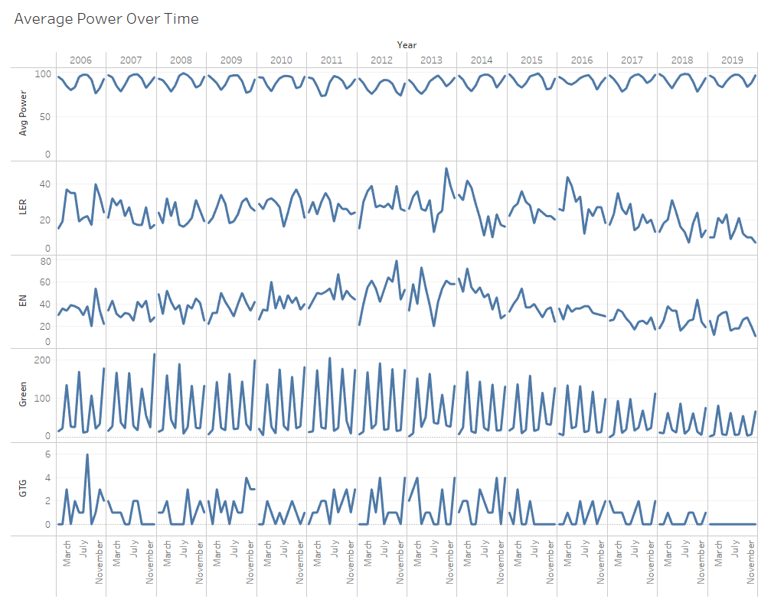
Looking for inverse relationship with Average Power

Slide 5
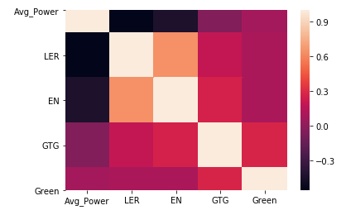
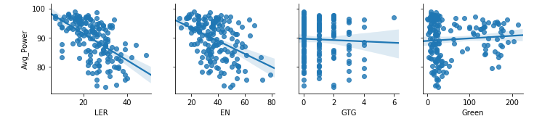
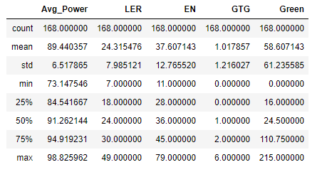
As expected, LER has the strongest correlation followed by EN.
LER and EN have a strong correlation together. ENs would encompass LERs.
Range is about 25%
Min is 73%
More ENs than LERs.

Slide 6
Model – Linear Regression
First - Linear Regression with LER, EN, GTG, and Green
Testing indicated that train-test-split of 80/20 performs better than 70/20 or 90/10.
Second – Linear Regression with ONLY LER, 80/20
70/30 | 80/20 | 90/10
RMSE: 5.45 | RMSE: 5.37 | RMSE: 6.01

Slide 7
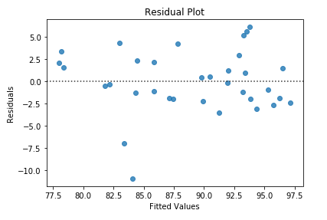


Results
80/20 with LER, EN, Green, and GTG resulted in RMSE of 5.37.
80/20 with LER resulted in RMSE of 5.36.
Using only the LER yields slightly better results.

Slide 8
Also tried…
Per a specific plant – Seabrook (NH), Waterford (LA), and Harris (NC)
Problems with low non-zero data when broken monthly. Evaluated annually (average number of LERs was ~3).
Predicted using LER, EN, GTG, and Green.
Harris had the highest amount of non-zero data
Seabrook | Waterford | Harris
RMSE: 11.05 | RMSE: 7.27 | RMSE: 5.56

Slide 9
Next Steps
Use non-public industry data to see how the predictions for power output turn out.

Slide 10
Summary
Licensee Event Reports can be an indicator of power plant power output.
Inspection Green and GTG reports could potentially provide lots of data, but do not have the Event Date.

